Slide 1

BACHELOR OF COMPUTER APPLICATION [BCA] Year: 2024– 2025
Project Report On
FbScore
Submitted for Partial Fulfilment towards the Degree Of
Submitted TO:
M. K. INSTITUTE OF COMPUTER STUDIES
Under the Guidance of
Chirag Patel
Submitted by
Seat no: 975, Name: Mohmed Imran Patel

Slide 2
FbScore
A Comprehensive Football Management System for Teams, Players, and Match Officials

Slide 3
Project Profile
Project Name: | FbScore
Developed By | Mohmed Imran Patel
Exam Seat No. | 975
Roll No. | 22B076
College Details: | Name : M.K.Institute of computer studies Address : Old NH-8,College Campus, Bharuch Phone : 02642 225637 Email: mkinstitute@gmail.com Website : www.mkics.ac.in
Internal Guide : | Chirag Patel
Technology Used | MERN STACK

Slide 4
Project Introduction
FbScore is an advanced football management system designed to handle team and match operations efficiently.
It consists of four main roles:
Admin: Manages the entire system, users, and platform operations.
Team Owner: Creates teams, hires players, and manages team activities.
Match Official: Organizes matches, updates scores, and manages statistics.
Players: Compete in matches and contribute to their teams.
The system provides a structured and efficient platform for football management.

Slide 5
Project Overview
FbScore is a football management system that simplify team and match coordination.
Key Functionalities:
Players participate in matches.
Team Owners create teams and recruit players.
Match Officials schedule matches and update scores.
Admins manage everything, ensuring smooth operations.
The system helps in tracking performances, match outcomes, and player statistics.

Slide 6
Project Planning
Scope
FbScore is a football management system for organizing teams, scheduling matches, and tracking performance.
User Roles:
Admin: Manages platform operations.
Team Owners: Form and manage teams.
Match Officials: Schedule matches and update scores.
Players: Compete and monitor performance.
Key Features:
Live match updates.
User-friendly interface.

Slide 7
Project Goal & Constraints
Goal
Simplify football management by handling teams, matches, and performance tracking.
Key Features:
Team Owners manage players.
Match Officials create matches and update scores.
Players track stats and team details.
Admins monitor and maintain the system.
Constraints
Internet Dependency – Real-time updates need a stable connection.

Slide 8
Technology & Software Requirement
Technology Stack
MERN Stack: Full-stack JavaScript framework ensuring scalability and efficiency. Frontend: React.js (UI), HTML5 & CSS3 (Design), Bootstrap (Mobile-friendly), JavaScript (ES6+). Backend: Node.js (Server), Express.js (API framework), MongoDB (NoSQL database).
Development & Hosting Tools
Vercel: Hosting for frontend & backend. Git & GitHub: Version control & collaboration. Postman: API testing. Code Editor: Visual Studio Code / Cursor. Browser: Google Chrome for best performance.

Slide 9
Feasibility Study
Economic Feasibility
Cost-effective due to free & open-source technologies.
Technical Feasibility
Uses MERN stack (MongoDB, Express.js, React.js, Node.js).
Open-source technologies ensure easy access.
Dev tools: VS Code, Cursor, GitHub, Postman.
Operational Feasibility
User-friendly interface for admins, team owners, players.
Automates match creation, team registration & player management.
Web-based system ensures accessibility on any device.

Slide 10
Requirement Analysis & Development Process
Requirement Analysis
Admin manages platform
Team owners handle teams
Match officials update matches
Players join teams, view matches
Development Process
Defined user roles & features
Built MongoDB database, Express.js APIs
Developed UI in React.js
Functional testing, optimization
Hosted on Vercel, updates

Slide 11
System Advantages
User Role Management – Ensures controlled access.
Efficient Team Handling – Owners recruit & manage players.
Match Scheduling & Updates – Officials update in real-time.
Real-time Scores & Stats – Tracks performance accurately.
Automated Record Keeping – Reduces errors.
Scalable & Accessible – Web-based, available anywhere.
User-Friendly Interface – Easy navigation.

Slide 12
Security & Precautions
Security Issues:
Unauthorized access & data breaches.
Injection & DDoS attacks.
Weak authentication risks.
Precautions Taken:
Authentication – Secure login with hashed passwords.
JWT Authorization – Controls user access.
Data Encryption – Protects sensitive info.
Input Validation – Prevents injection risks.

Slide 13
Overview of Main Entities Schema
Admin:
2. Match Official:
3. Team
Field Name | Data Type | Constraints | Description
name | String | Required, Trim | Admin's full name
pic | String | Optional | Profile picture URL
adminId | String | Required, Unique | Unique admin identifier
password | String | Required | Admin account password
timestamps | Date | Auto-generated | Record creation and update timestamps
Field Name | Data Type | Constraints
name | String | Required
email | String | Required
password | String | Required
Field Name | Data Type | Constraints
teamname | String | Required, Unique
teamlogo | String | Default: Empty String
country | String | Required
createdBy | String | Required
email | String | Required
password | String | Required
active | Boolean | Default: True

Slide 14
Overview of Main Entities Schema
4. User:
5. Match
Field Name | Data Type | Constraints
name | String | Required
email | String | Required, Unique
dob | Date | Required
gender | String | Required
country | String | Required
password | String | Required
position | String | Required
foot | String | Required
pic | String | Optional
active | Boolean | Default: True
Field | Type | Description
teamA | ObjectId (ref: Team) | Required
teamB | ObjectId (ref: Team) | Required
score | Object | Default: {teamA: 0, teamB: 0}
goals | Array | Scorer, Assist, Team, Timestamp
match_date | String | Required
match_time | String | Required
status | String | Enum: Upcoming, Live, etc. (Default: Upcoming)
mvp | ObjectId (ref: Player) | Optional
createdBy | ObjectId (ref: MatchOfficial) | Required
timestamps | Boolean | True

Slide 15
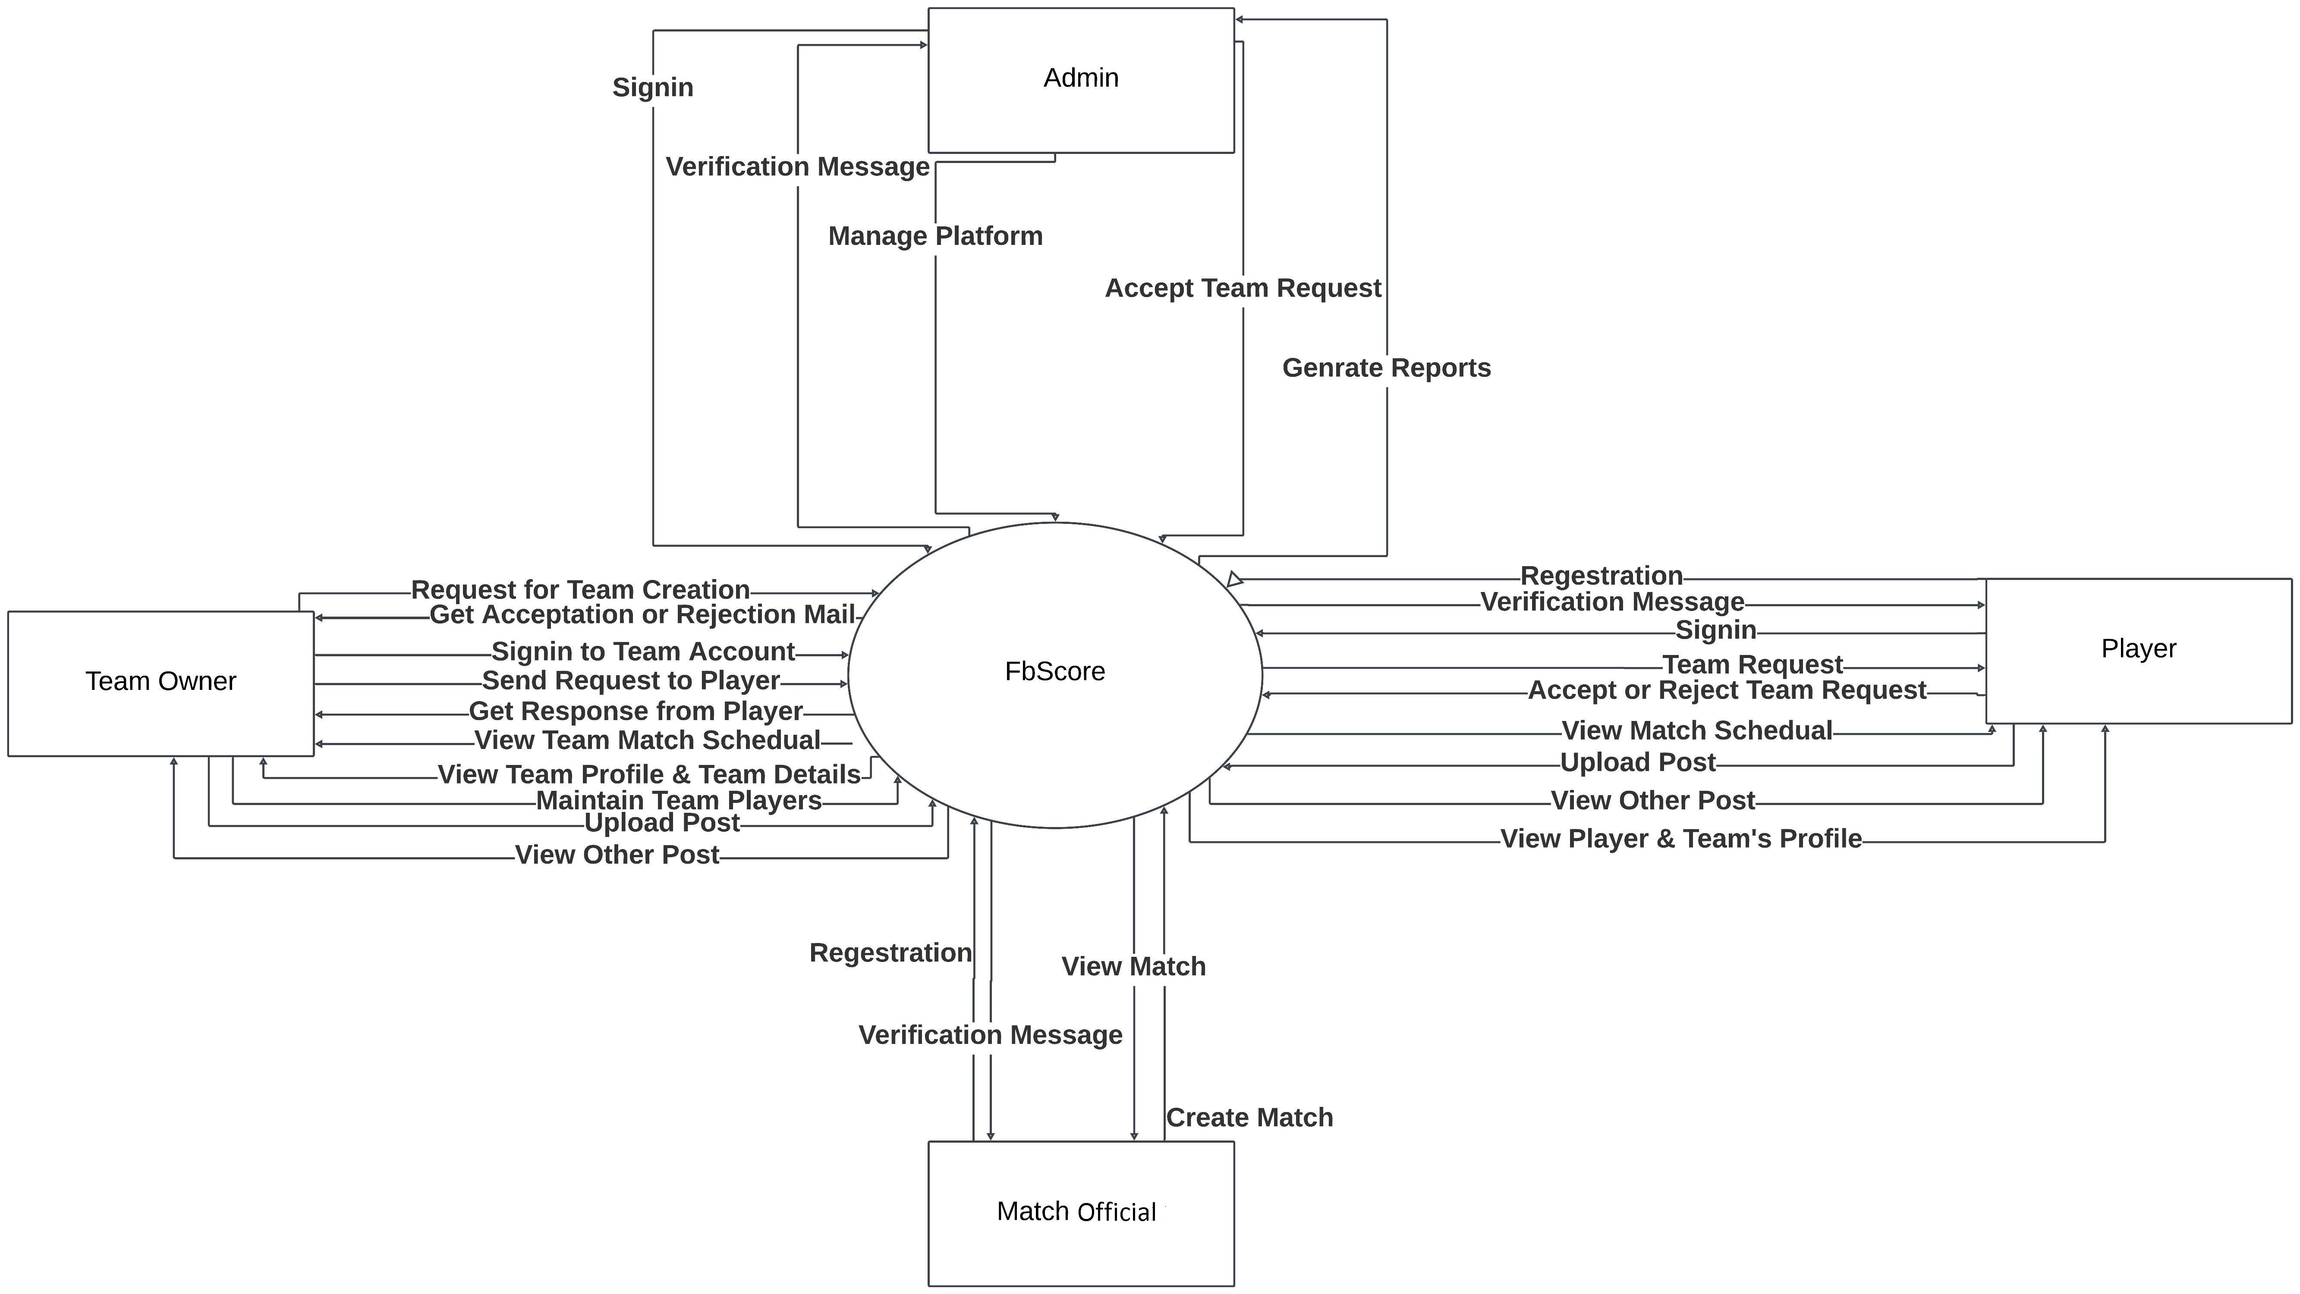
Data Flow Diagram-Context Level

Slide 16
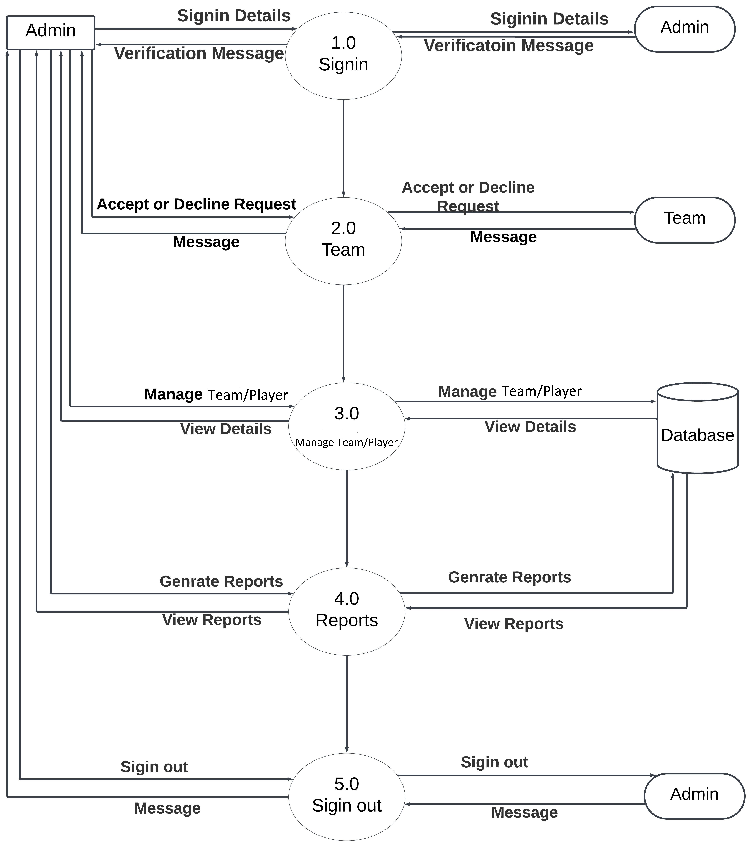
Data Flow Diagram-1st Level for Admin

Slide 17
Data Flow Diagram-1st Level for Team

Slide 18
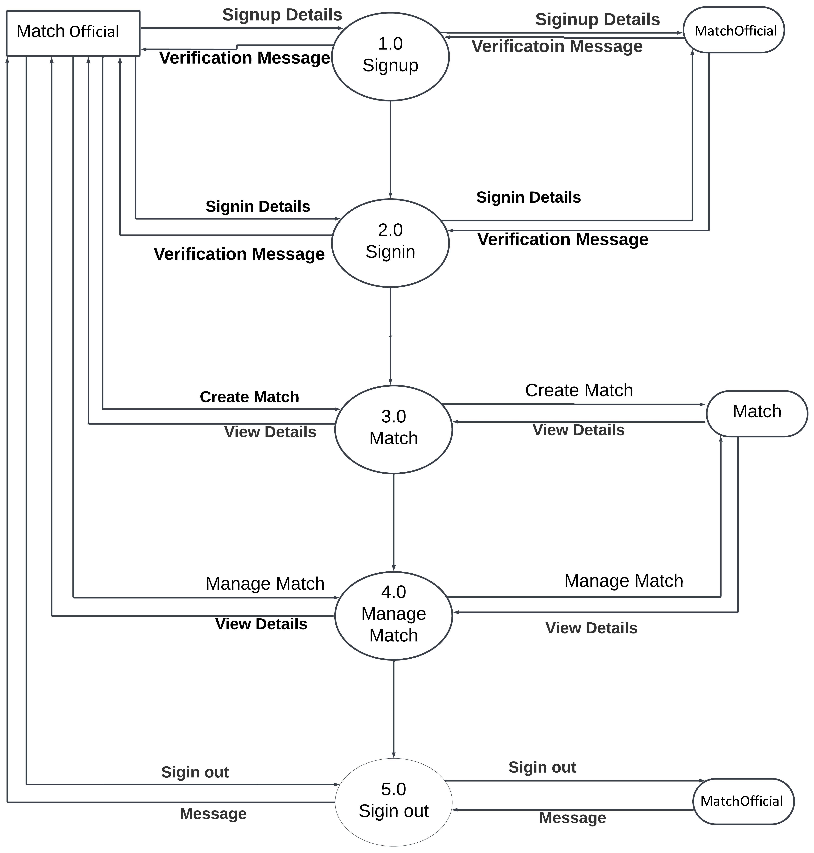
Data Flow Diagram-1st Level for Match Official

Slide 19
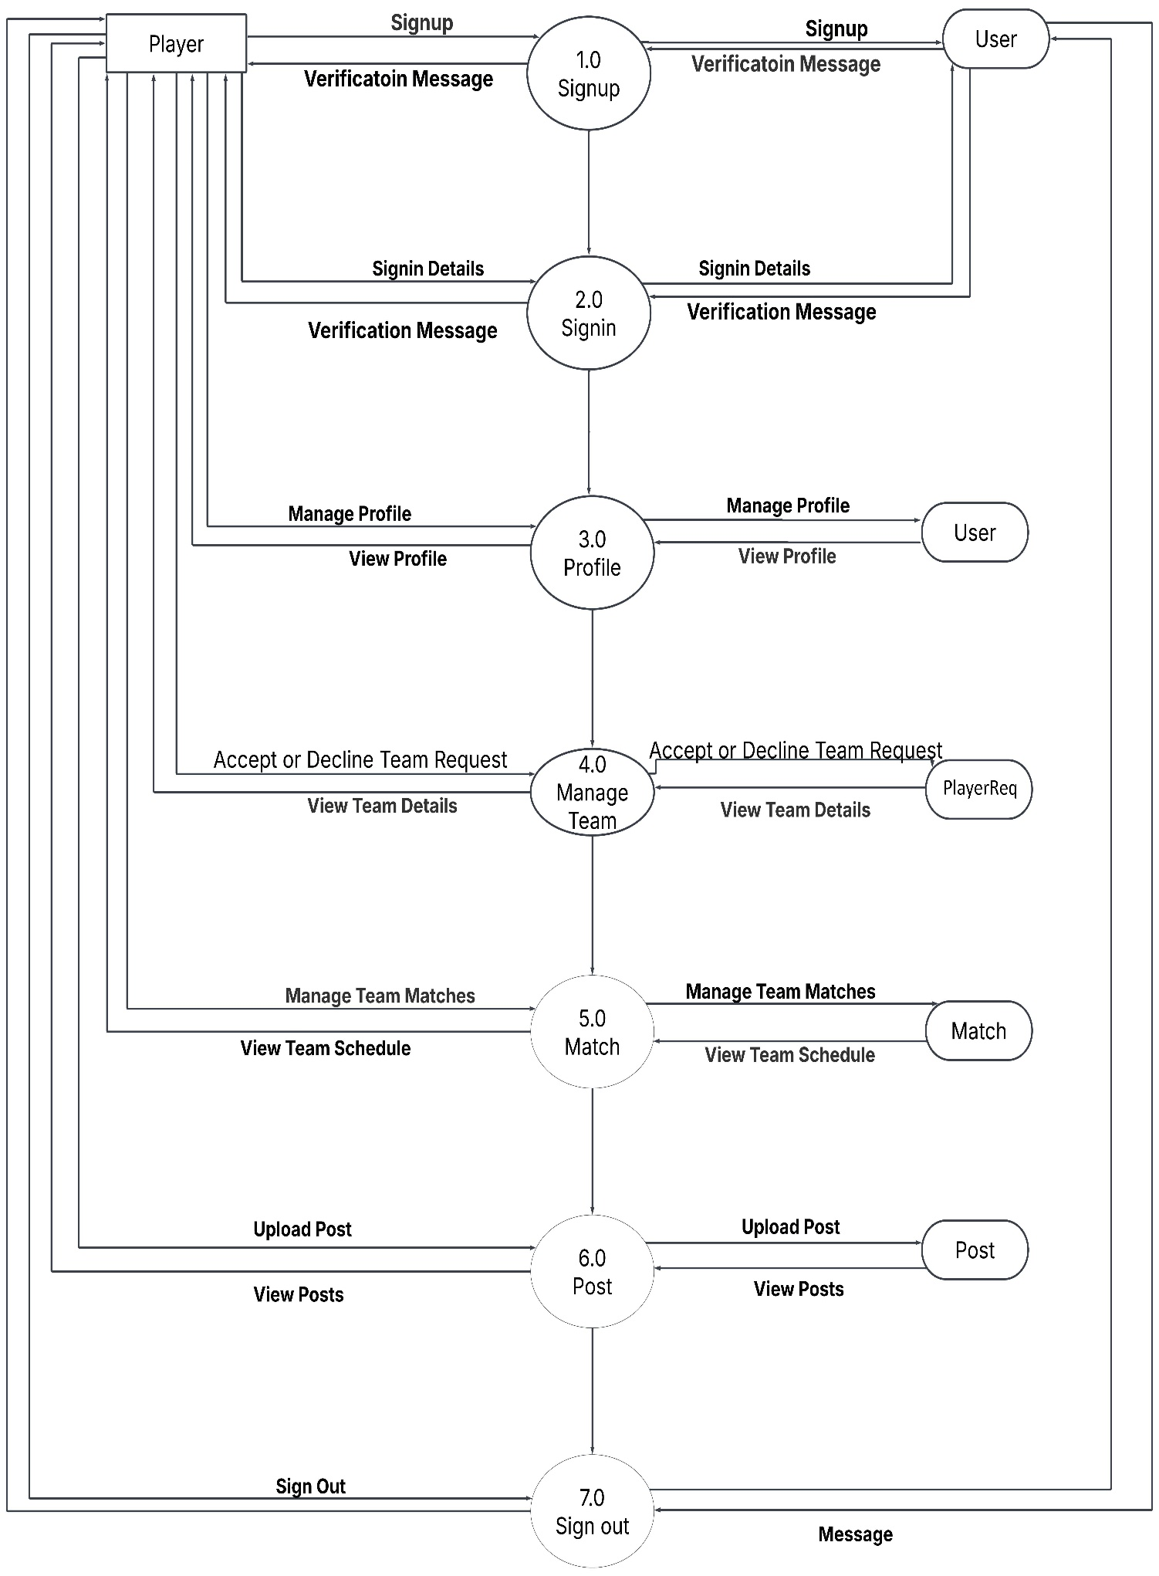
Data Flow Diagram-1st Level for Player

Slide 20
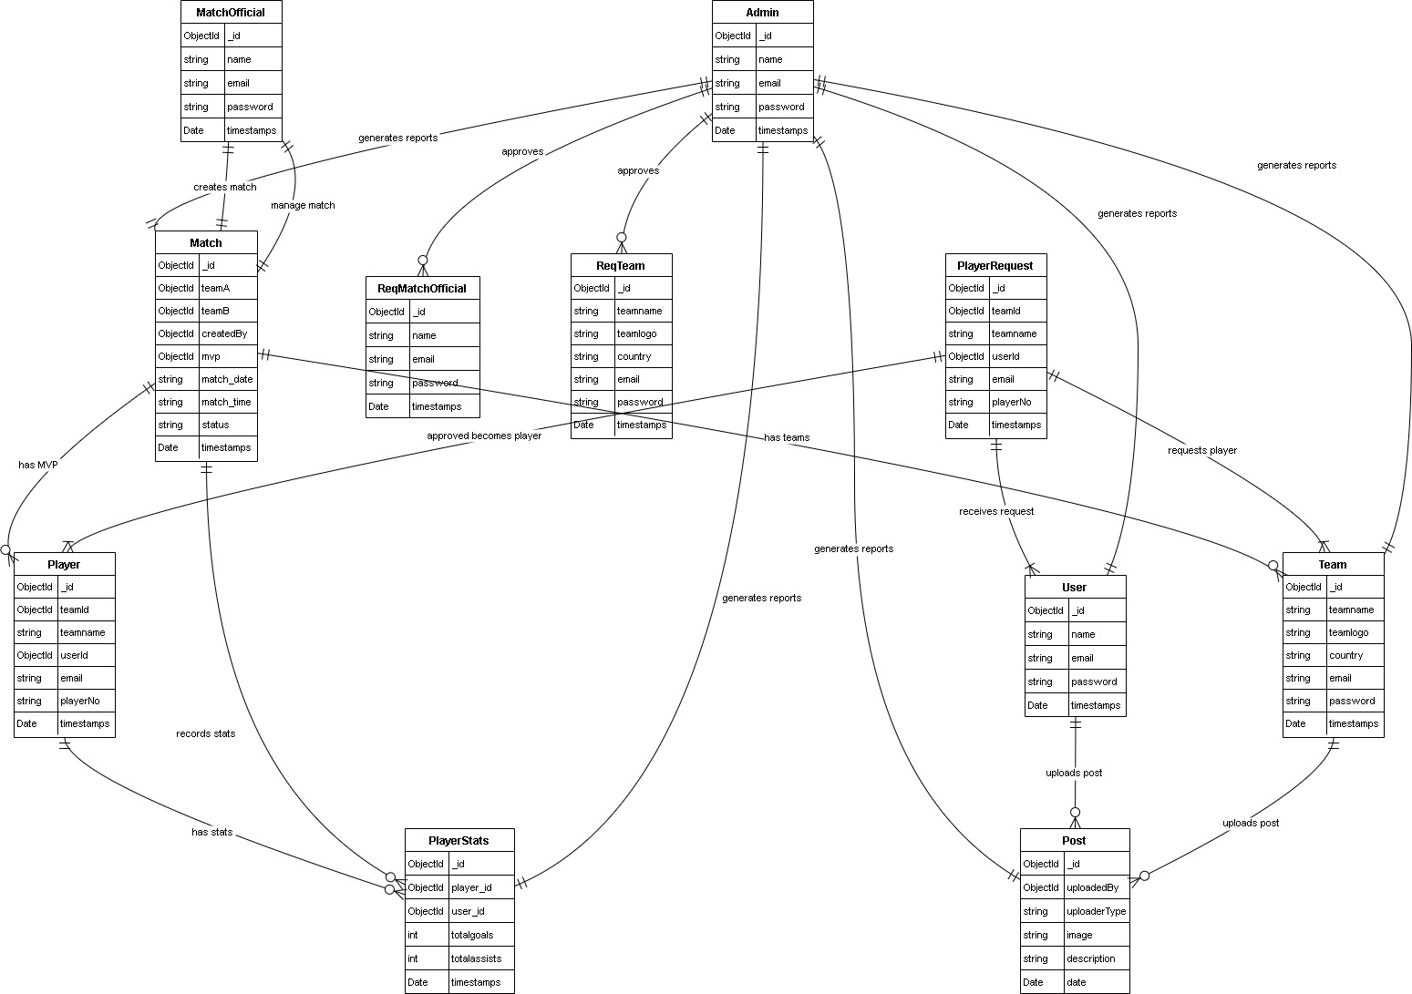
ER-Diagram
Click here for Live Demo

Slide 21
System Testing Overview
What is System Testing?
Ensures all modules function correctly and work together.
Verifies functional correctness, performance efficiency, and reliability.
Testing methods used:
Unit Testing
Postman API Testing
Response Time Analysis

Slide 22
Unit Testing & Results
Unit Testing ensures individual components work correctly before integration.
Key Modules Tested:
User Authentication – Signup, Signin, Password hashing, Token generation
Team Management – Team creation, Updates, Player removal
Match Operations – Match scheduling, Status updates, MVP assignment
Results:
98% test coverage achieved
All core functionalities passed successfully

Slide 23
API and Performance Testing Results
Postman API Testing
Tested user authentication, team, and match APIs
96% success rate, avg. response: 200-350ms
Response Time Analysis (Avg. Response Times (ms)):
User Auth: 250
Match Creation: 320
Team Mgmt: 300
Match List: 280
Post Upload: 340
Environment: Node.js, MongoDB, Localhost

Slide 24
Future Enhancements
Planned Features for Improved Functionality & Security
Yearly Membership: Annual fee for teams & officials with renewal reminders and premium analytics.
Fine System: Admin-controlled fines for suspended teams & players to maintain discipline.
Security Upgrades: Two-Factor Authentication, better token management, and stronger data encryption.
Advanced Analytics: Player stats, historical match records, and leaderboards for competitive tracking.
Pitch Charts: Visual match overviews with player positions, heat maps, and tactical insights.
Conclusion: These enhancements will improve engagement, fairness, and security, making the system more efficient and professional.

Slide 25
Bibliography
Technology & Documentation
MongoDB Docs: mongodb.com/docs
Express.js Docs: expressjs.com
React Docs: react.dev
Css Framework
Bootstrap: getbootstrap.com
API Testing's & Deployment
Postman: postman.com
Vercel: vercel.com/docs

Slide 26
The End
A Comprehensive Football Management System for Teams, Players, and Match Officials

